Slide 1
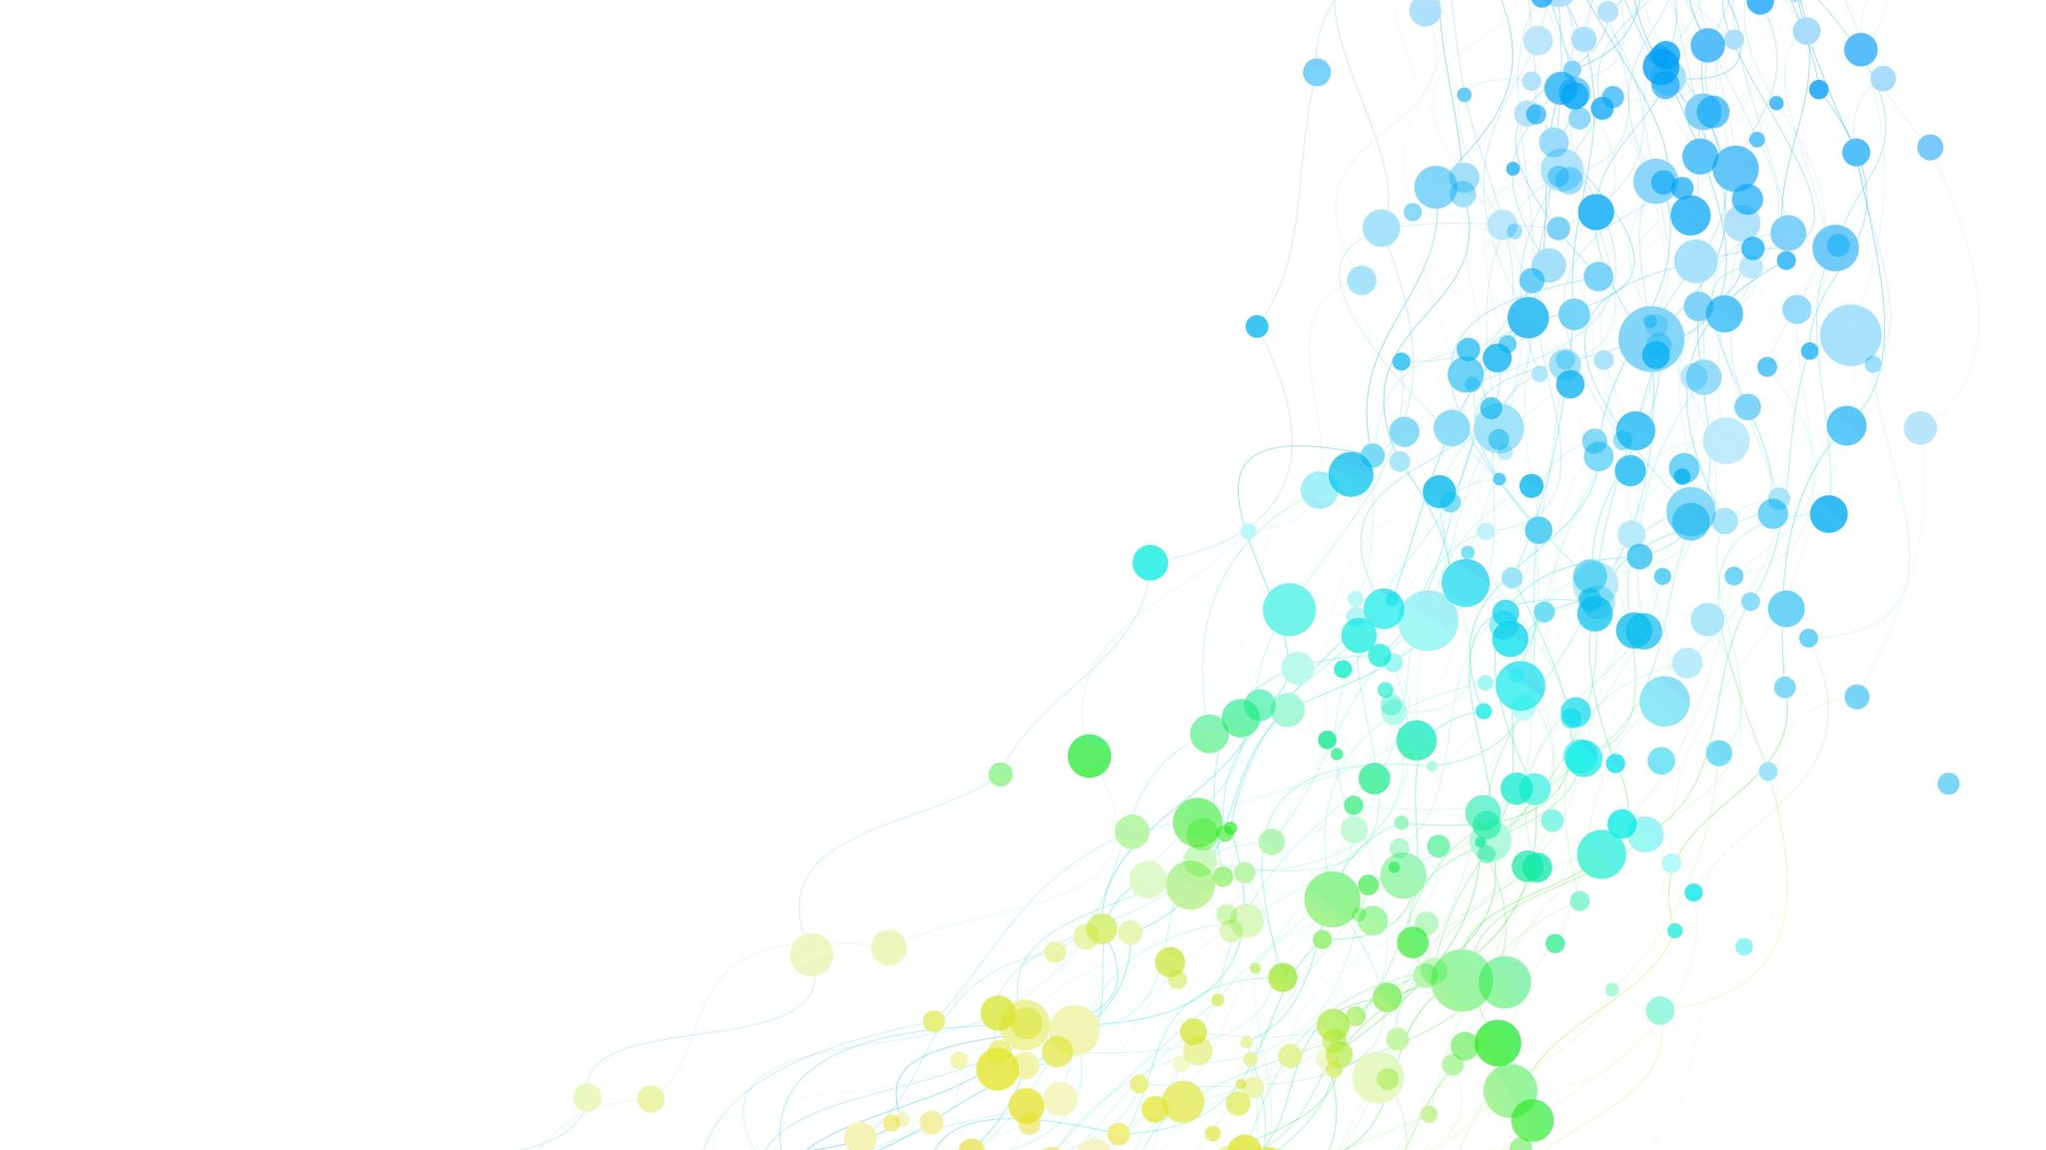
Division of Hospital Medicine Patient Volume Dashboard
Sean Vieau
Fall 2025 Practicum
preceptor: Dr. Angela Keniston

Slide 2
Goal
Support DHM in providing care for over 50% of the patients at CU Hospital by developing a data visualization dashboard that tracks and monitors patient volumes and capacities for each service line and team

Slide 3
Steps
Data Preparation
Data Exploration and Visualization
Design Dashboard
Develop RShiny App

Slide 4
Data Preparation

Slide 5
Data Sources
Volumes: DHM Daily Morning Census.xlsx
Capacities: DHMTeamCaps AY21-AY26 v.11.7.25.xlsx
Target Volumes (To be added): DHMTeamTargets_AY25-AY26 v.11.7.25.xlsx

Slide 6
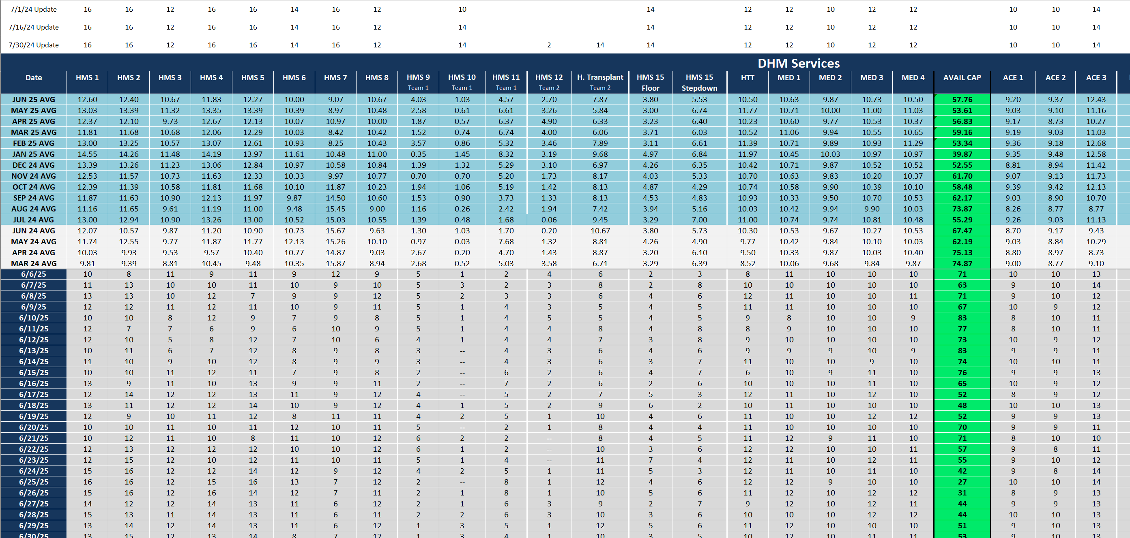
Data Sources
Morning Census.xlsx

Slide 7
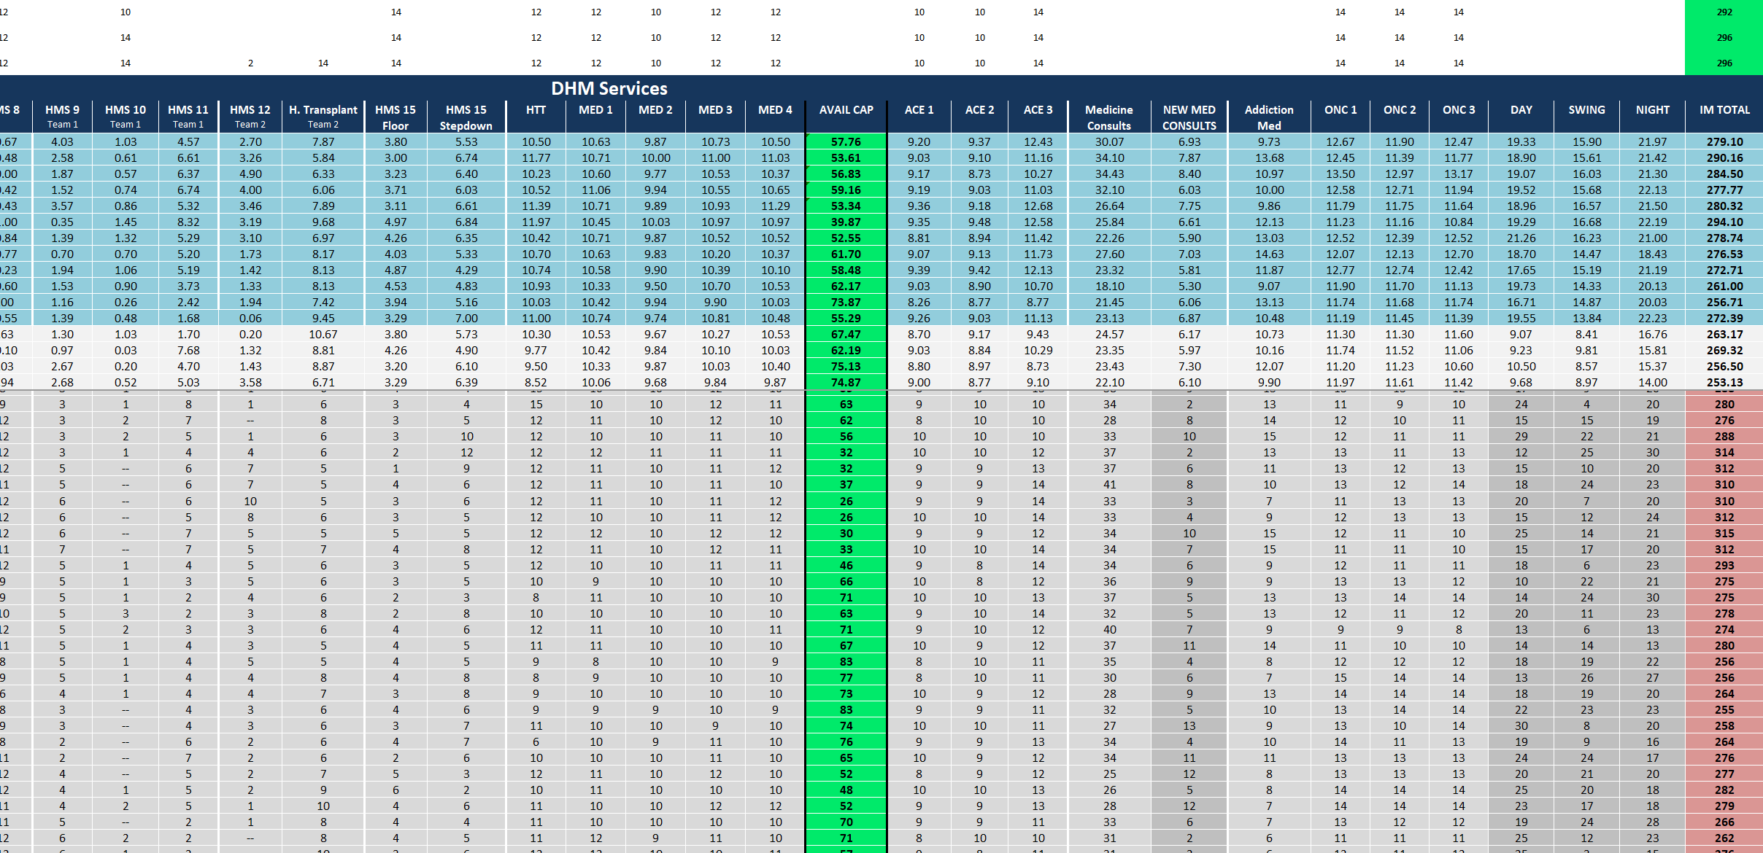
Morning Census.xlsx

Slide 8
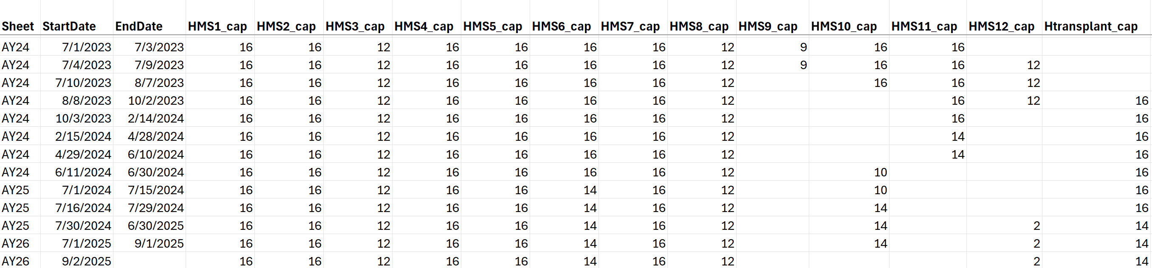
Daily Capacities.xlsx

Slide 9
Target Capacities.xlsx

Slide 10
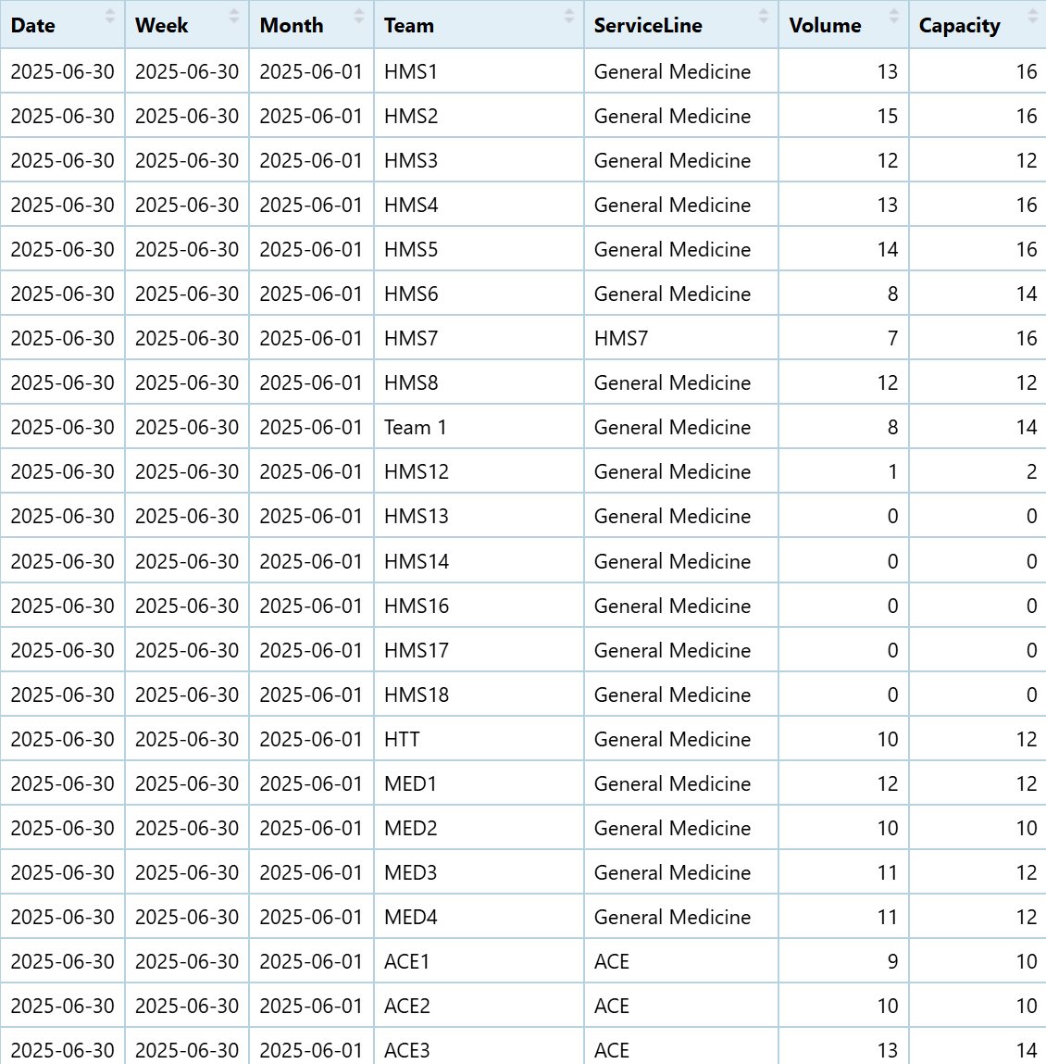
Final Data Set

Slide 11
Data Exploration and Visualization

Slide 12
Data Exploration and Visualization
Explored a range of idioms before settling on the most insightful

Slide 13
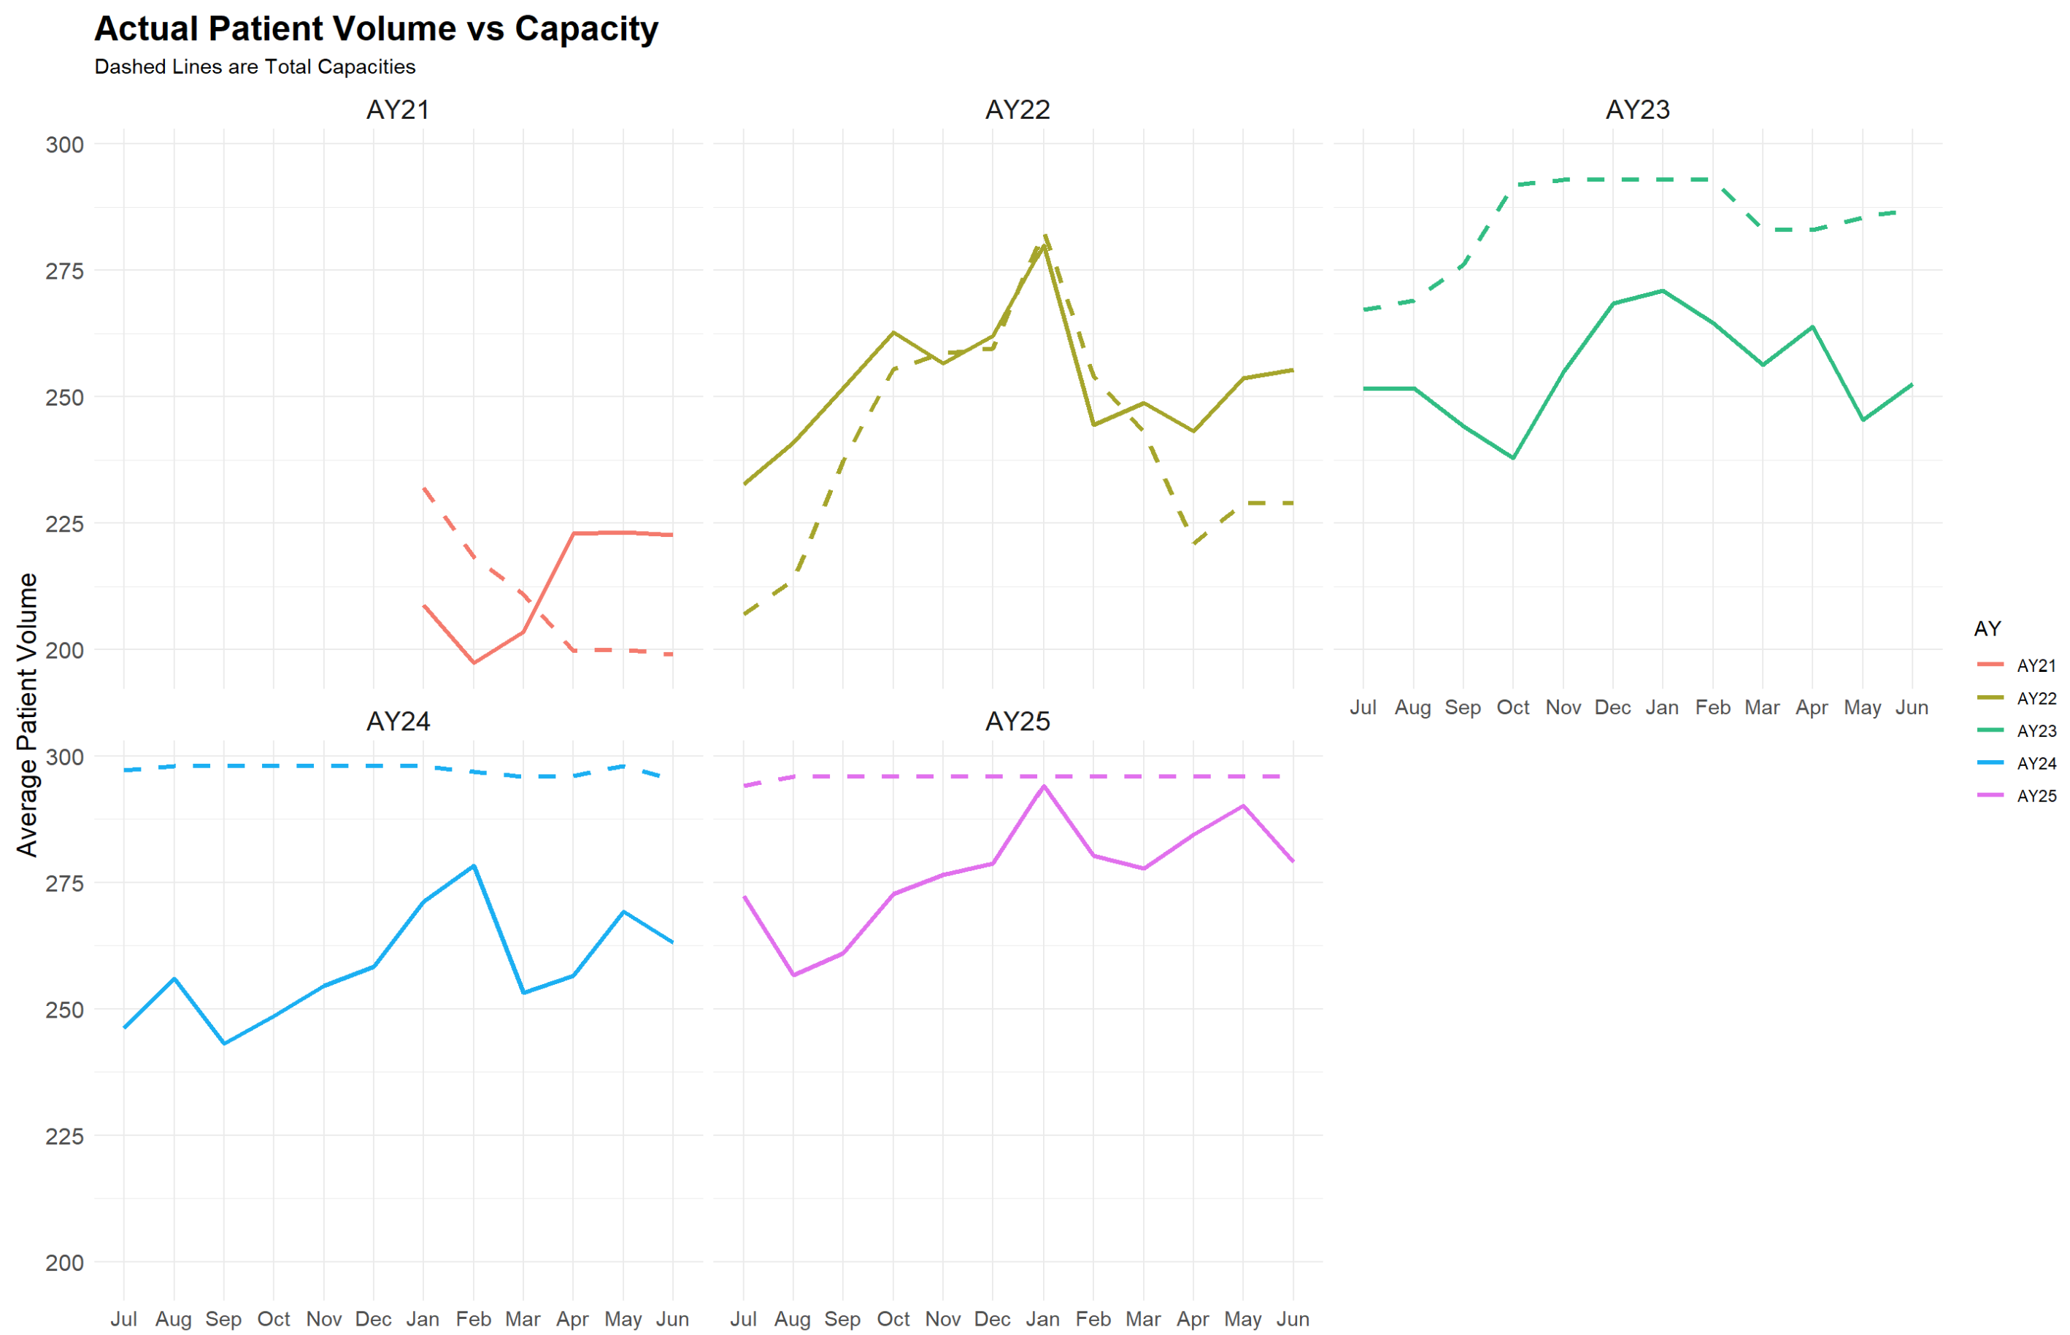
Volume Line Plots

Slide 14
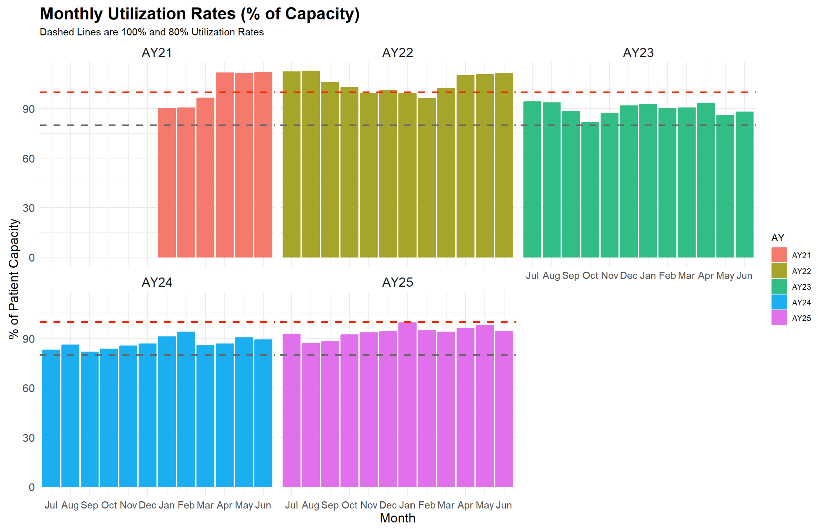
Capacity Bar Plots

Slide 15
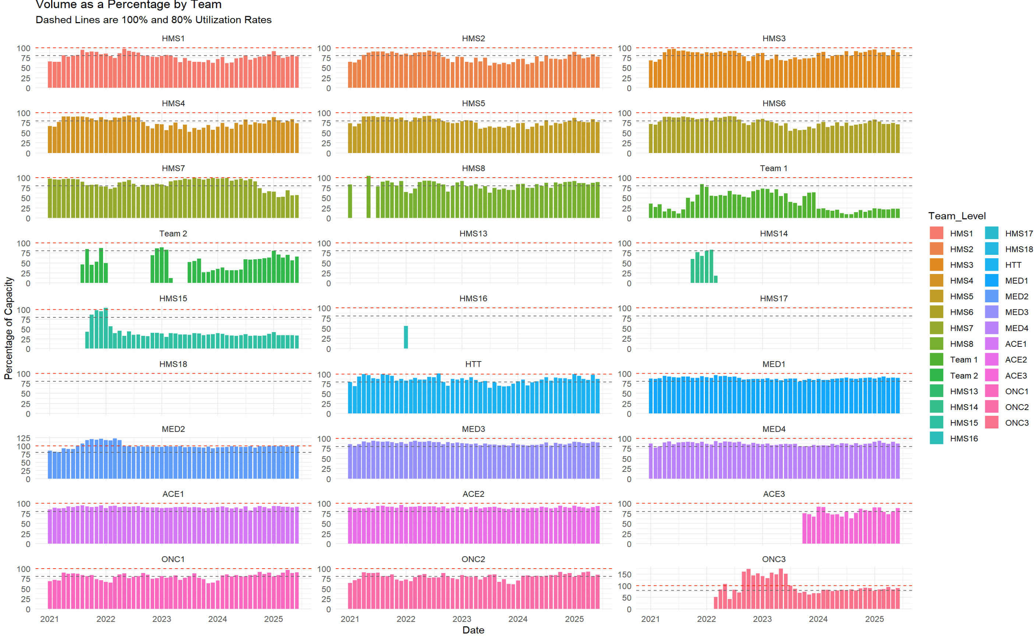
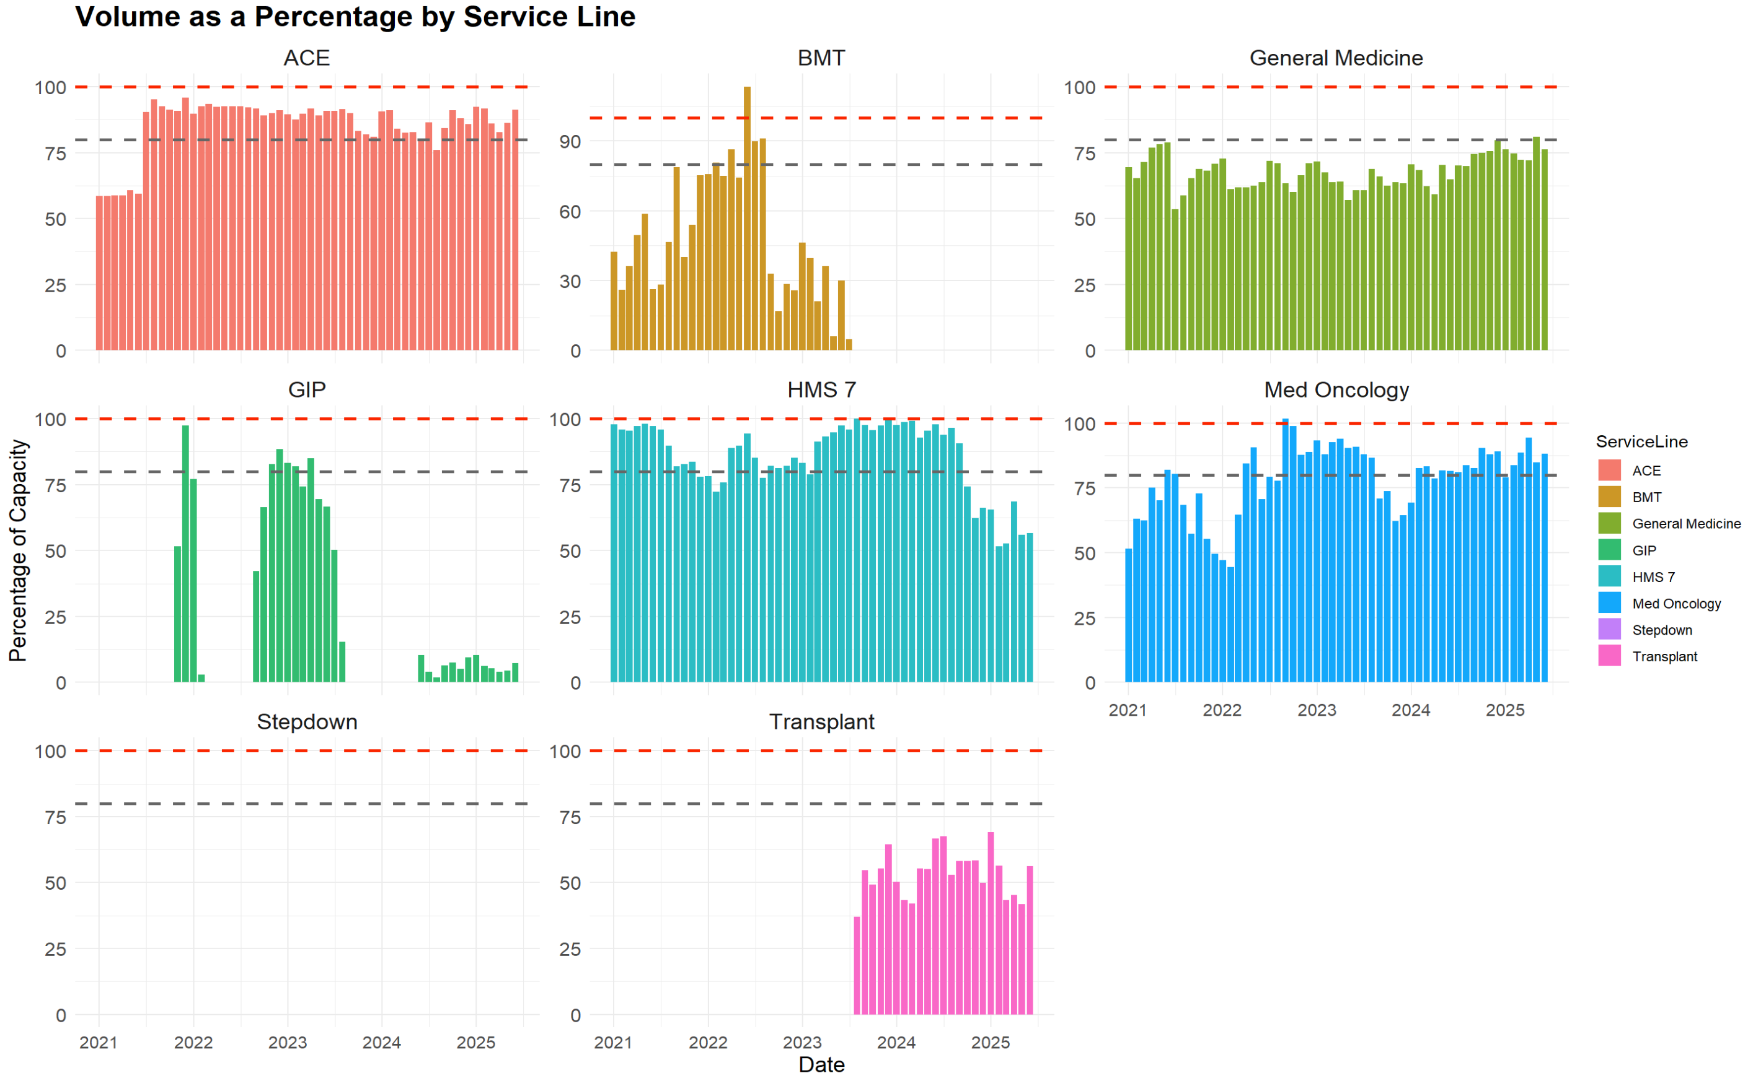
Drill Down Provides Further Insight
Click this plot
Should provide Team Level breakdown
Notes:
From Lauren Email:
“
The reason you’re seeing this discrepancy is because the IM total column includes our volumes for teams that do not have caps (e.g., our Medicine Consults and Addiction Med Consults teams – columns AF and AH in the AY25 sheet) while the AVAIL CAP column only accounts for teams that have assigned caps.
When you are plotting the available capacity for a given day, I would recommend using the totalcapacity_calc - IM TOTAL as this will be specific to teams that have caps
“

Slide 16
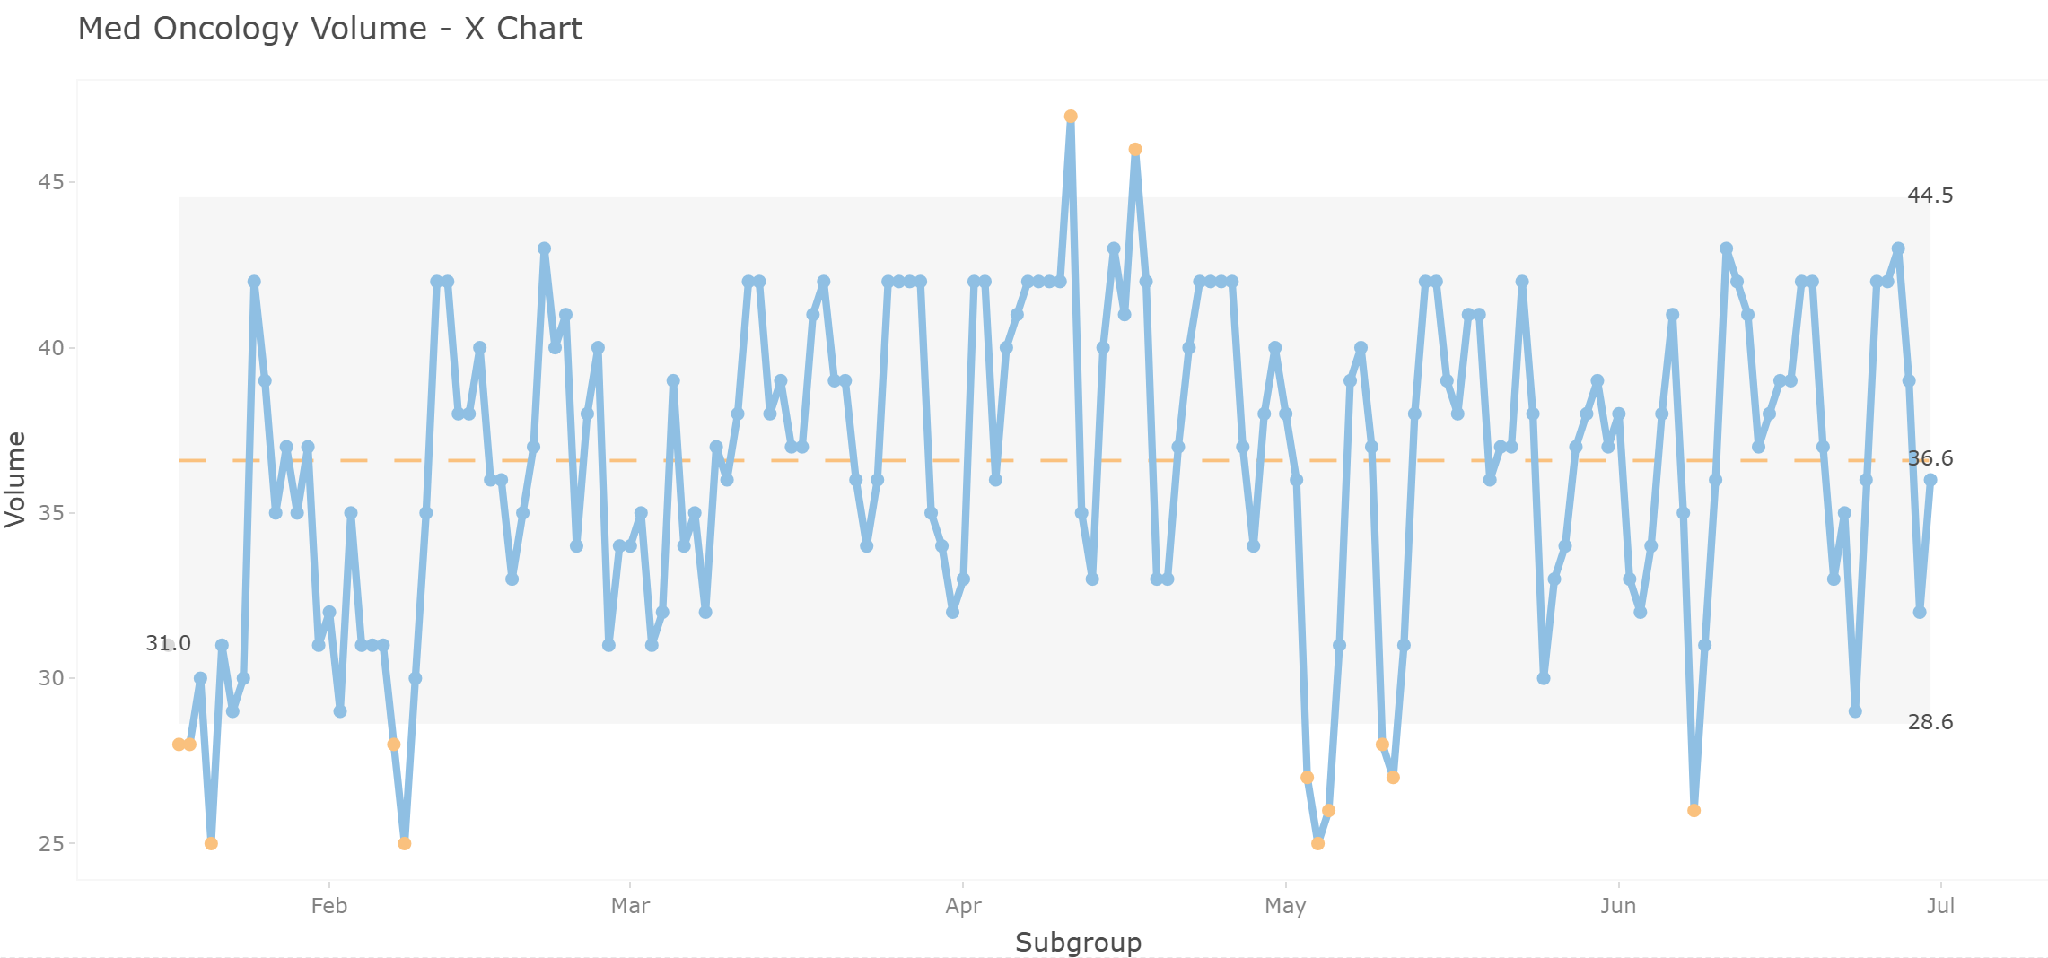
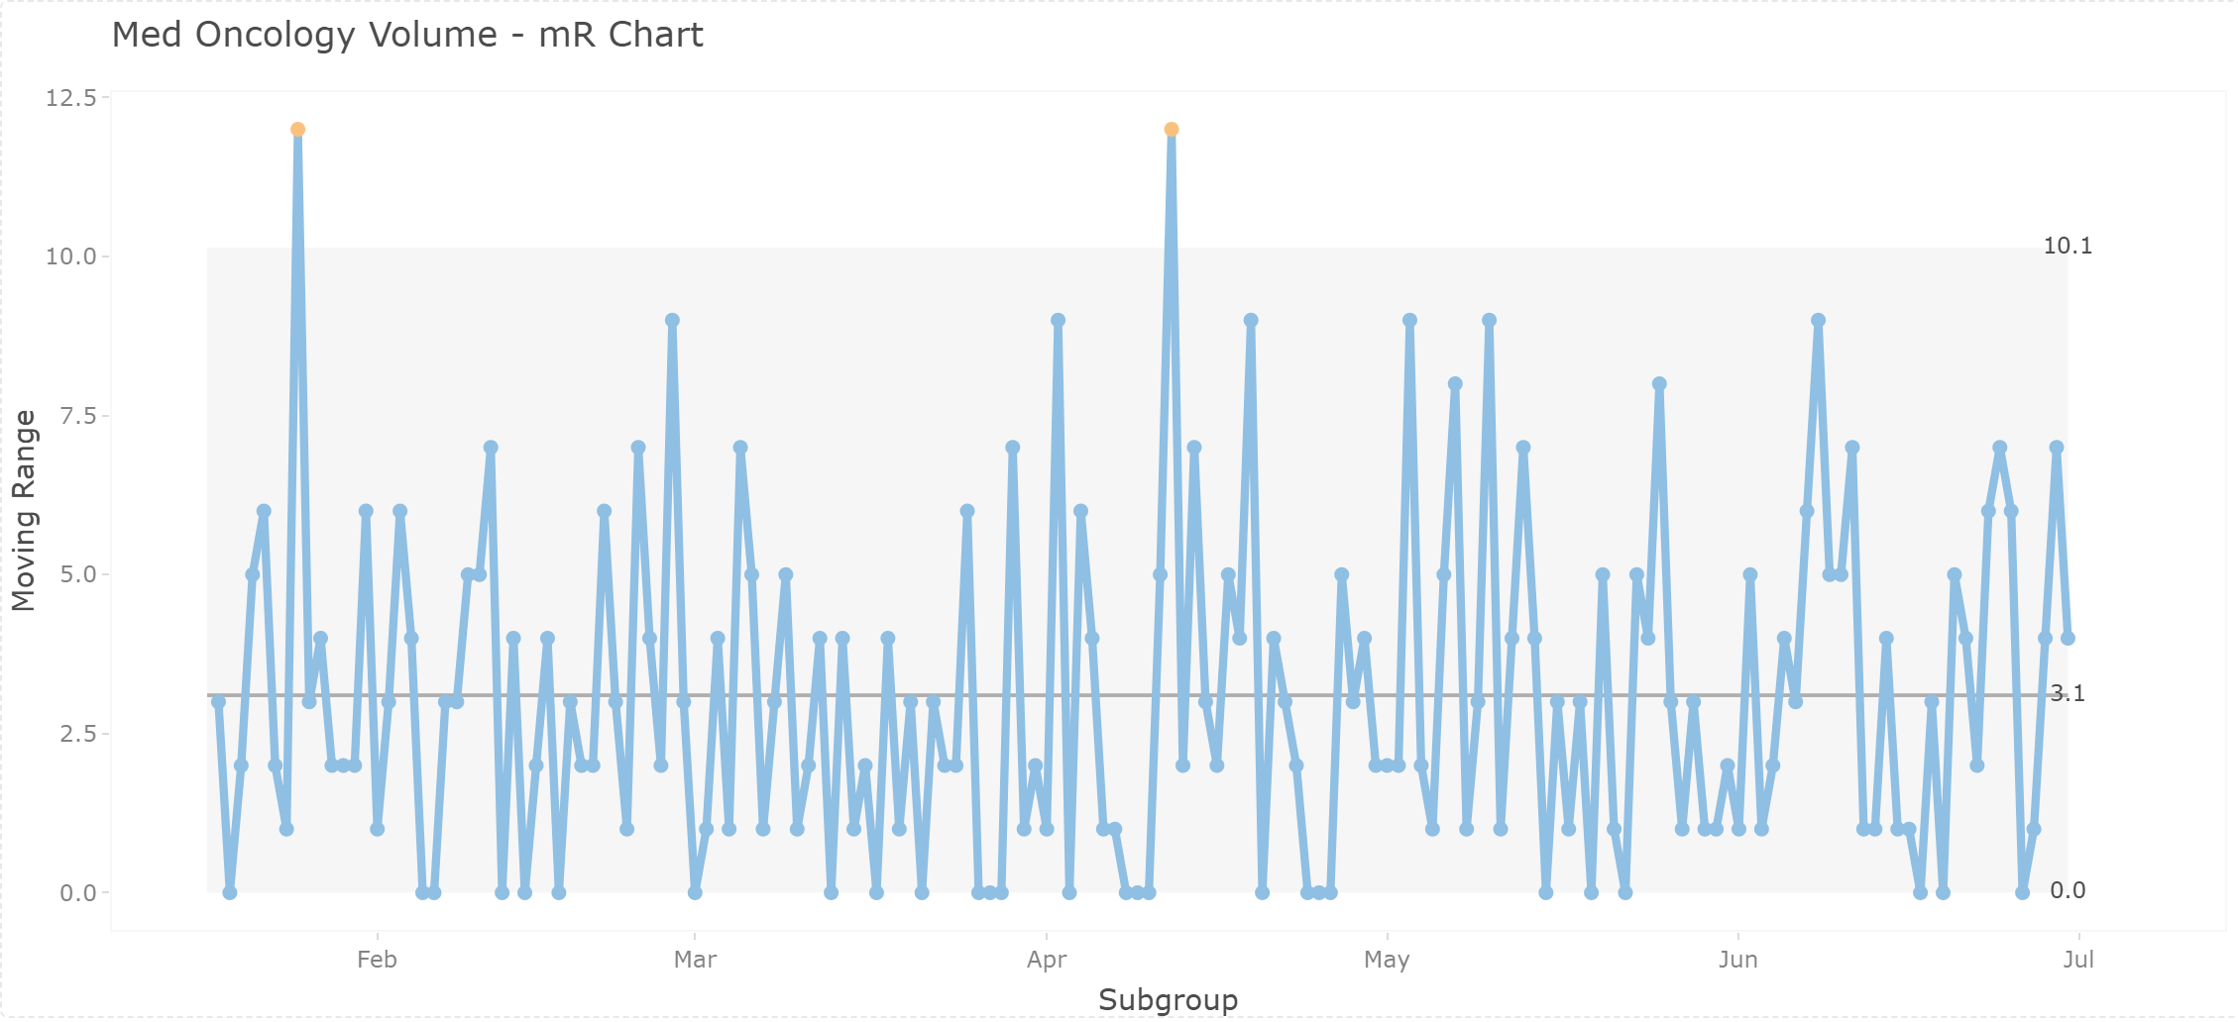
Statistical Process Control Charts
Notes:
From Lauren Email:
“
The reason you’re seeing this discrepancy is because the IM total column includes our volumes for teams that do not have caps (e.g., our Medicine Consults and Addiction Med Consults teams – columns AF and AH in the AY25 sheet) while the AVAIL CAP column only accounts for teams that have assigned caps.
When you are plotting the available capacity for a given day, I would recommend using the totalcapacity_calc - IM TOTAL as this will be specific to teams that have caps
“

Slide 17
Dashboard Design

Slide 18
Tasks Needed
Build custom plots for reporting and exploration
Monitor current health / operational pressure (e.g. volumes and capacities of each team the previous week)
Flag teams/service lines that are at risk of being above 80% / 100% capacity
Anticipate upcoming surges in patient volume, and be able to adjust accordingly
Simulate forecasted volumes under different staffing strategies. Adjust in real-time to avoid being over capacity.

Slide 19
Overall Design
Panels:
Current Health:
“What’s happening right now?”
Volume Forecasting:
“What might happen next?”
Custom Exploration:
“What do I need to report or explore?”

Slide 20
Task 1: Current Health Dashboard “Are we okay now?”
This is the daily/weekly monitoring mode, where users can:
Quickly assess which teams/Service Lines are at risk
Flags for sustained overcapacity (e.g. 3+ days > 90%)
See volume trends over the past week/2 weeks/month
Volume line plots, % of total capacity bar plots, SPC charts
Anticipate upcoming surges
Make staffing adjustments before things escalate
Stop problems before they become problems

Slide 21
Task 2: Volume Forecasting “What might happen next”
This is the prediction mode, where users can:
Analyze historical data and predict upcoming patient volumes
Anticipate upcoming surges in patient volume, and be able to adjust accordingly
Simulate forecasted volumes under different staffing strategies. Adjust in real-time to avoid being over capacity.
Could be wrapped together into the Current Health Dashboard

Slide 22
Task 3: Custom Exploration and Reporting “I want to explore on my own”, “I need to make a report”
This is the analyst mode, where users can:
Filter by specific date ranges, service lines, and aggregation levels (day, week, month)
Directly compare different service lines/teams
Build custom groups for storytelling (e.g. General Medicine + Med Onc)
Export visuals for presentations/reports (need to implement)

Slide 23
Develop App in RShiny

Slide 24
Coding the App
Developed interactive app in Rshiny
Focused on clean, modular code and reproducible workflows
Followed good coding practice
Clear comments for each block of code

Slide 25
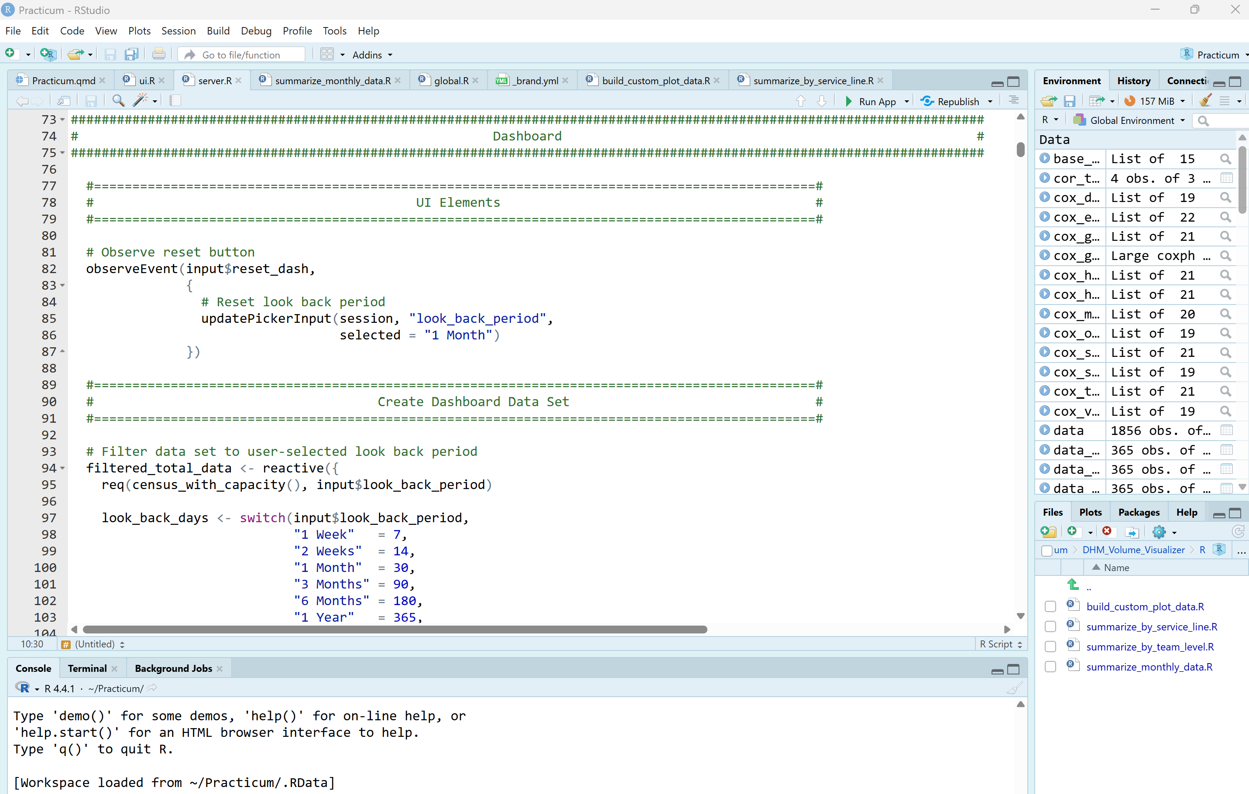

Slide 26
Design Philosophy

Slide 27
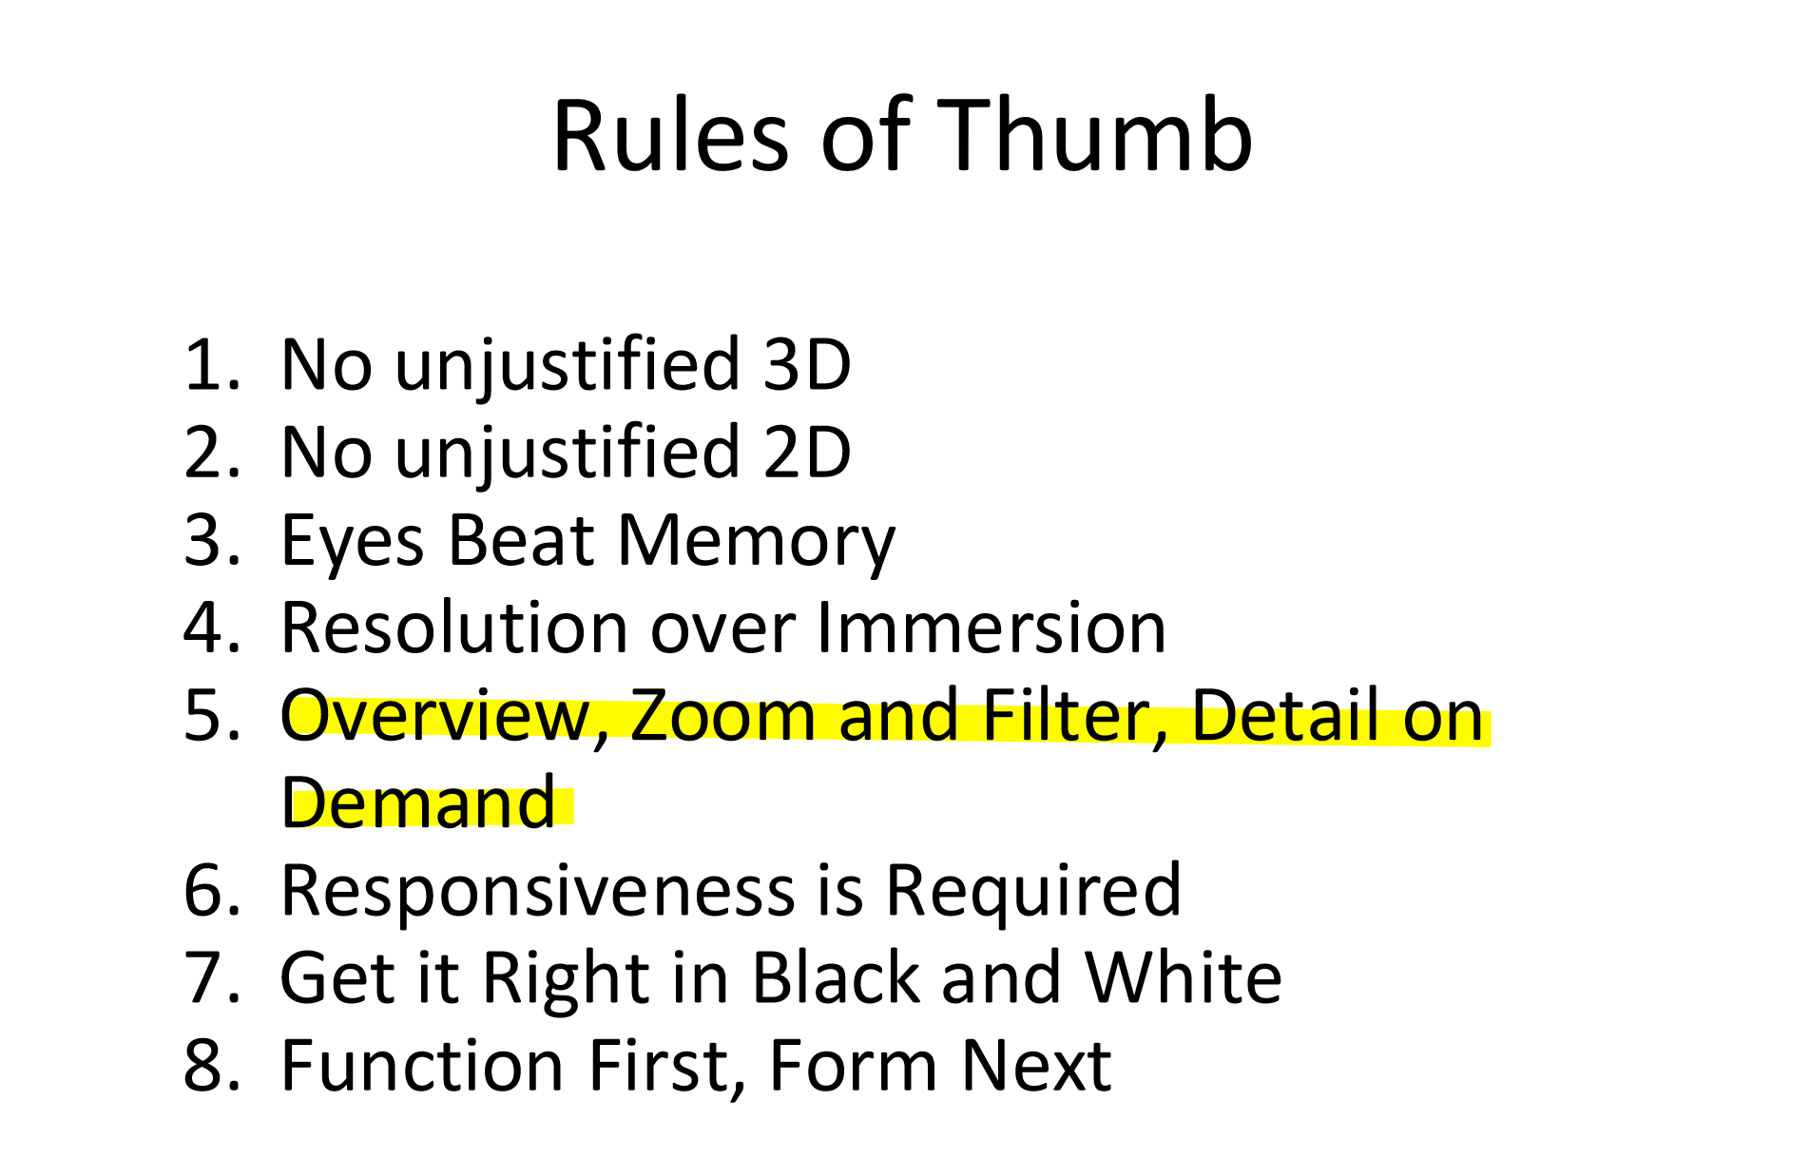
Design philosophy

Slide 28
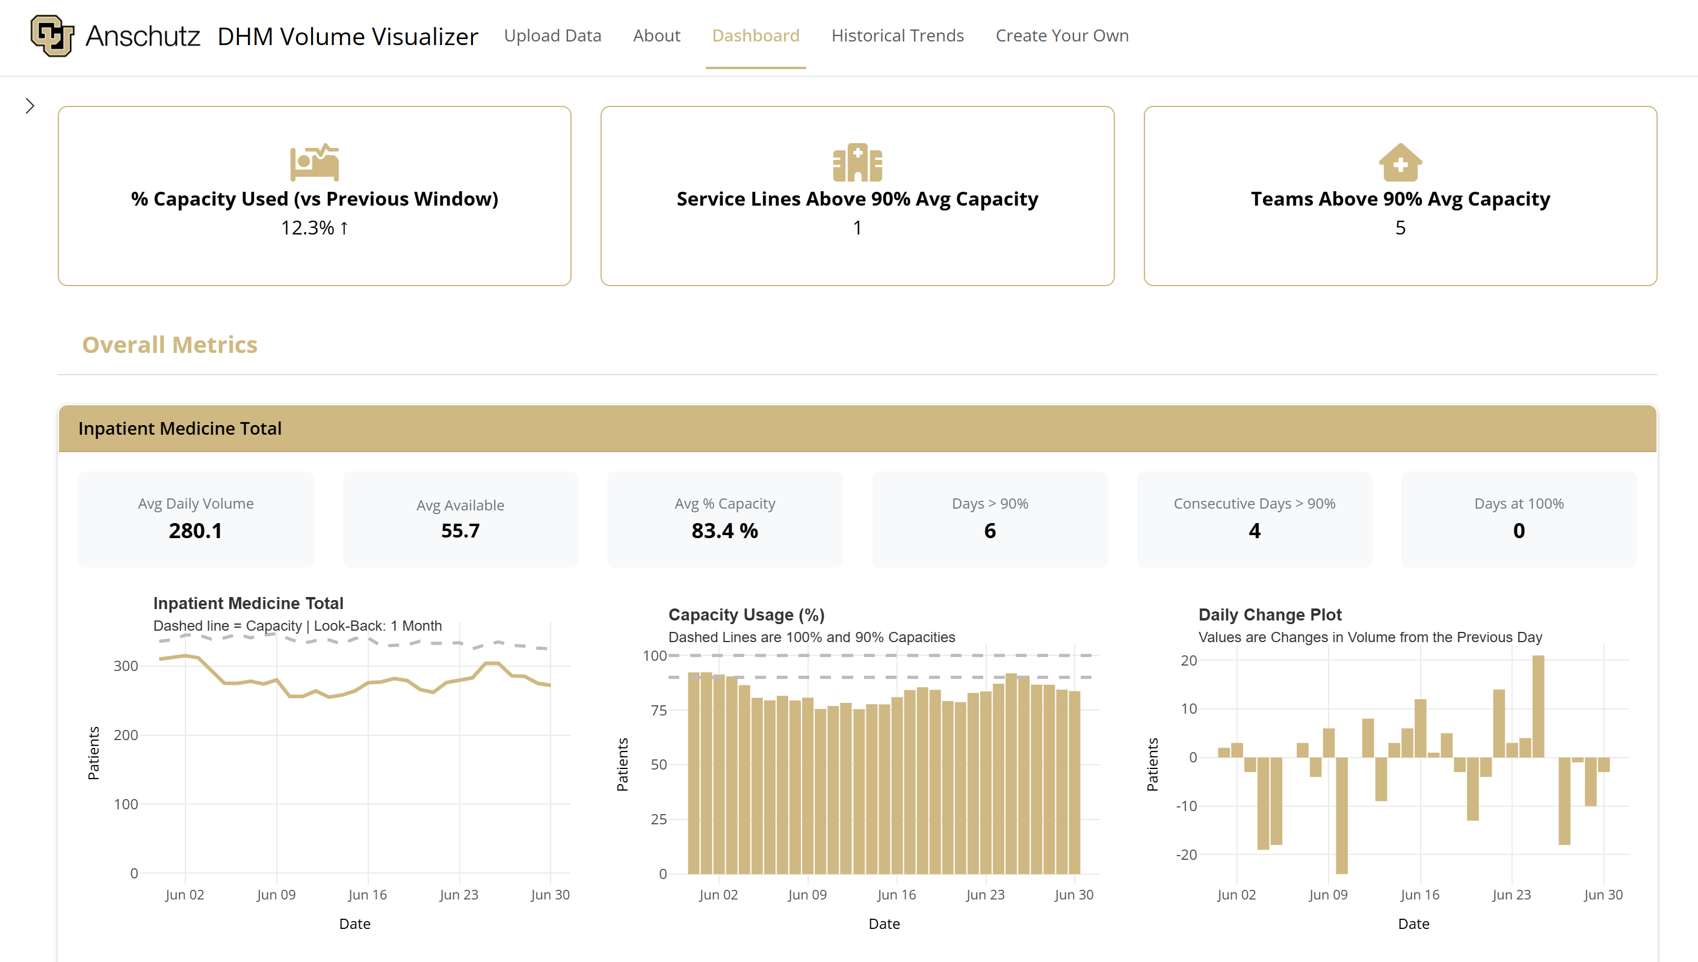
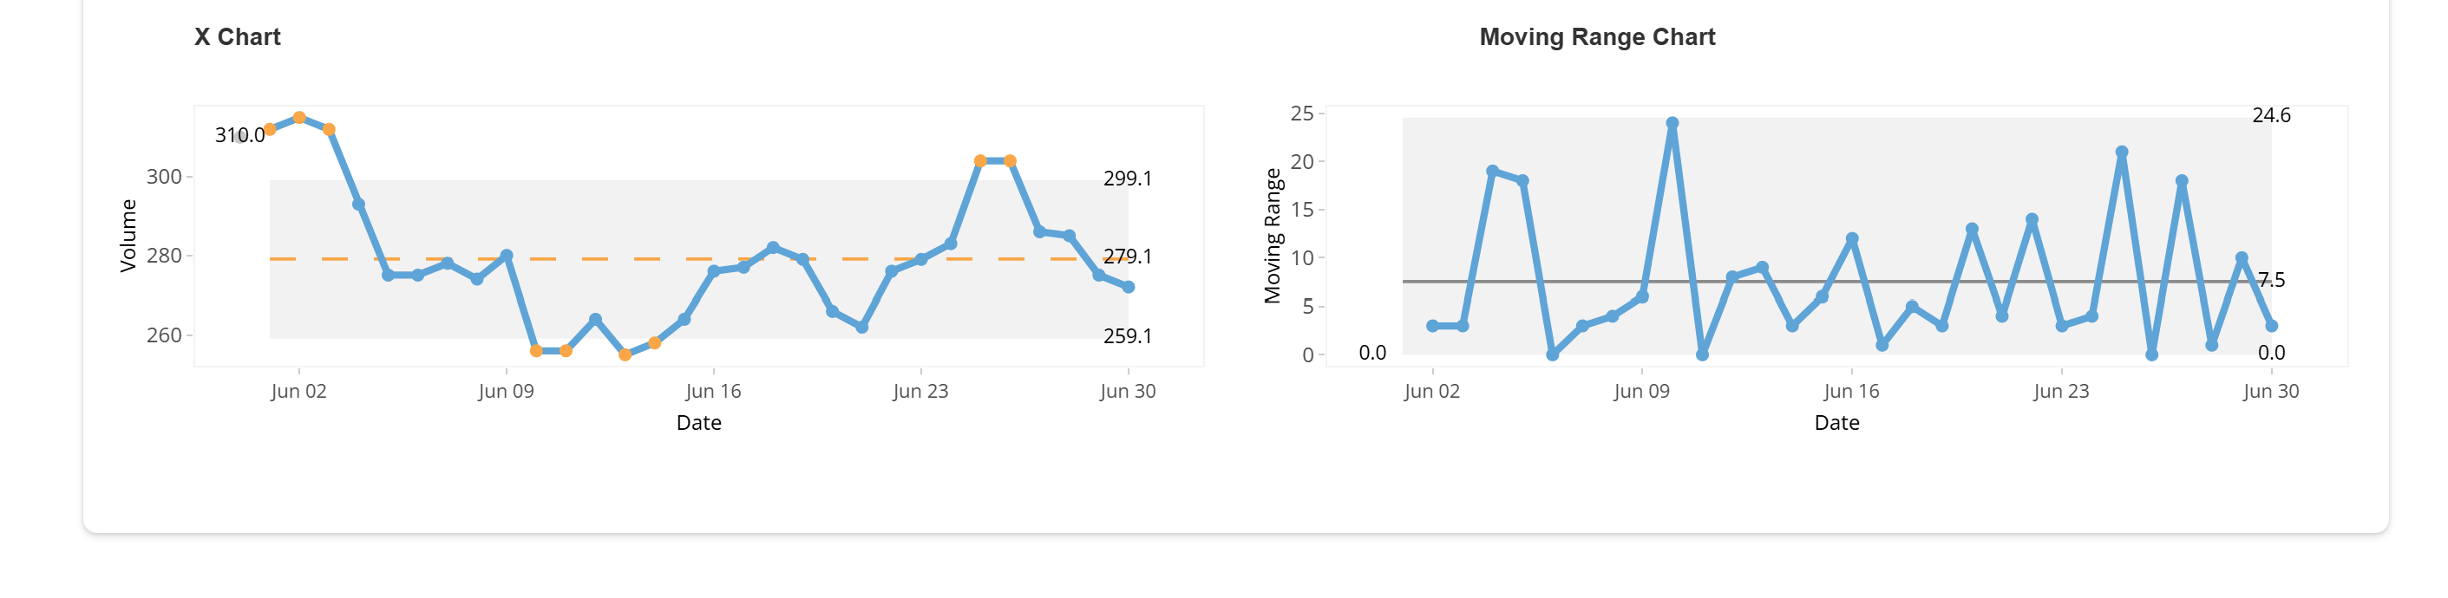
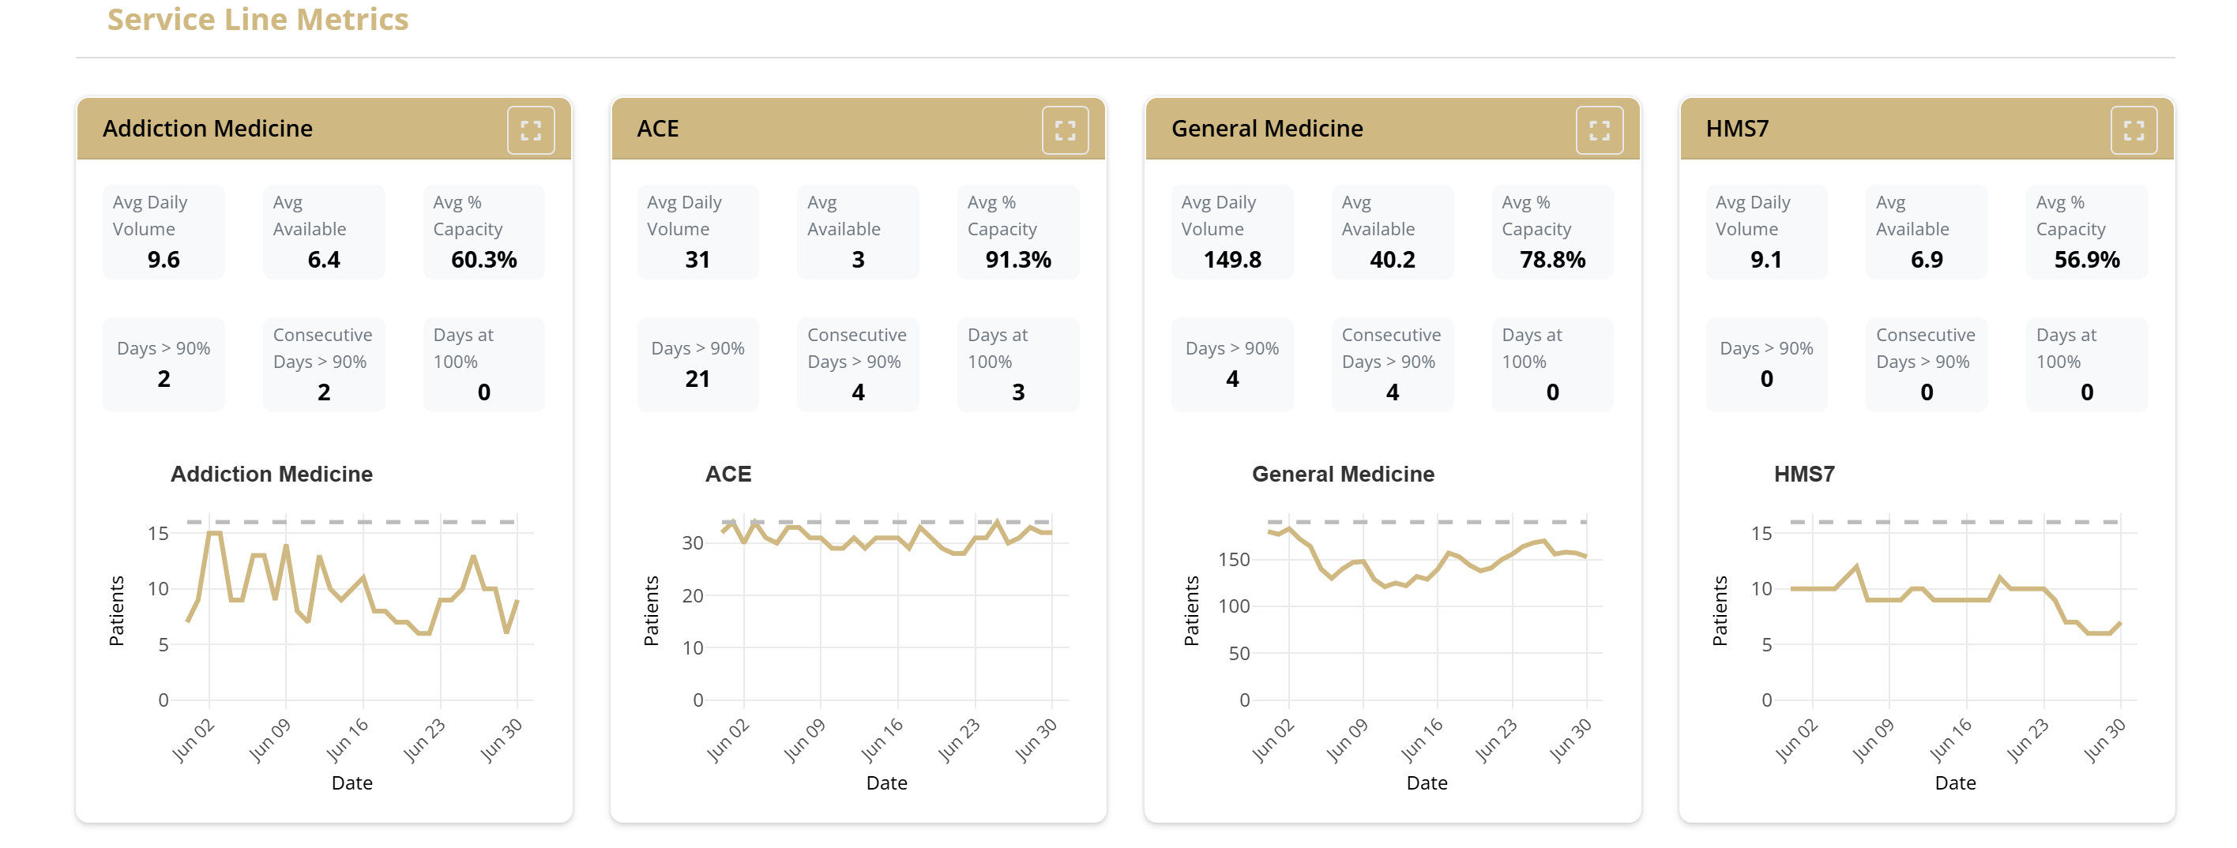
Design philosophy

Slide 29
Design philosophy
Global Summary Metrics

Slide 30
Design philosophy
Global Summary Metrics
Inpatient Medicine Total
Plots and Metrics

Slide 31
Design philosophy
Global Summary Metrics
Inpatient Medicine Total
Plots and Metrics
Individual Service Lines

Slide 32
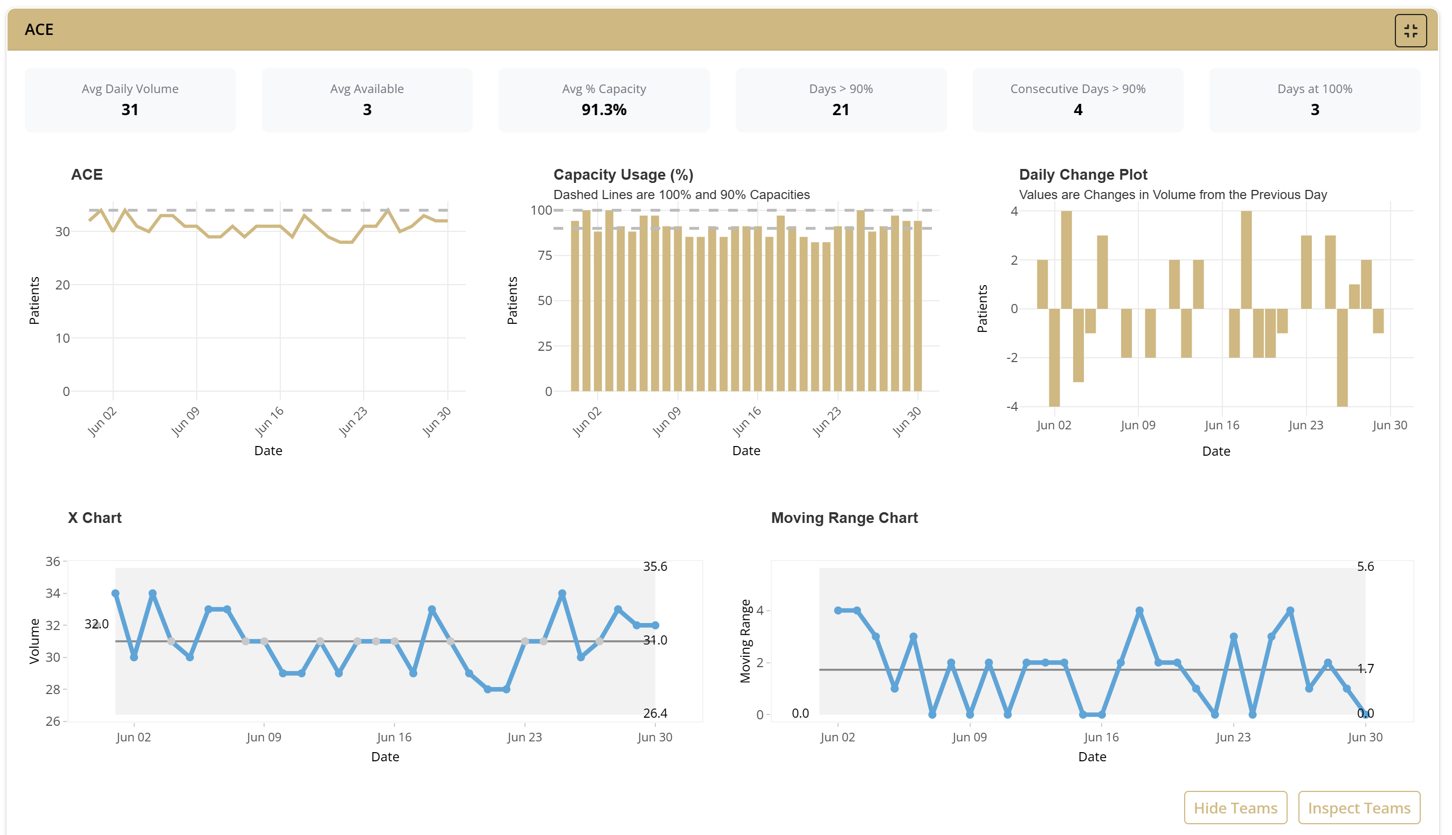
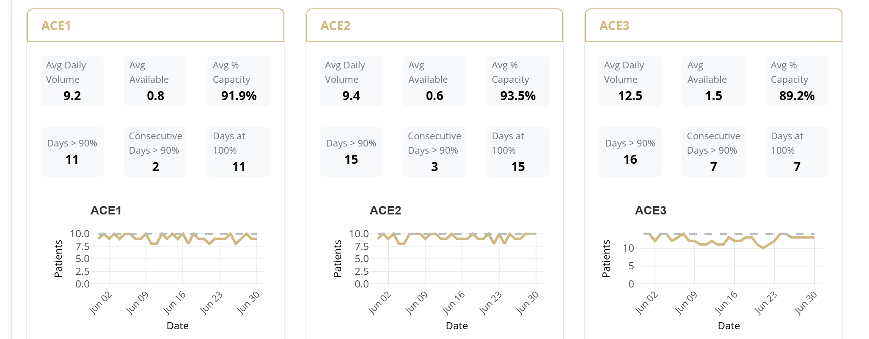
Design philosophy
Individual Service Lines
Individual Teams

Slide 33
Live Demonstration

Slide 34
Next Steps

Slide 35
Next Steps
~2 weeks left
Plan
Week 1: Examine FastTS usage to predict volumes
How accurate is it? Write up results
Week 2: Clean code, meet with Data Viz professor RE: RSHiny deployment, update app to include newest data set (+ Med Onc 4)
Week 3: Write user guide, record walk through of code, final adjustments
Final Deliverable: 12/7

Slide 36
Future Features
Add target numbers to the dashboard (in addition to cap)
% of time over target at the service level (each service has a different target)
Might only be applicable for AY26
Add color encoded flags to metrics
Cross Talk brushed highlighting with connected plots
Historical Trends tab fully actualized.
Add service line / team heat map
Find better SPC chart or alter the current package to show trends
Hover-over tooltips for all metrics
Future proof addition of new teams / service lines
Work with DHM statisticians to integrate forecasting model?

Slide 37
Bonus Slides

Slide 38
App Hosting Research results for best option
Host on a Website (shinyapp.io)
Docker Image
Downloadable Software
What: Cloud hosted shiny server hosted by Posit
Pros:
Zero set-up, click and go
Secure/Trustworthy (Posit)
Cons:
Highest security is paid ($119 per month)
But have workarounds!
What: Containerized version of app accessed via Docker software Pros:
Works offline
Cons:
Requires set-up (download Docker Desktop on every computer)
Learning curve
What: Self contained, downloadable app Pros:
Works offline
Cons:
Very high learning curve (packaging done with Electron software)
Clunky to iterate (next programmer has to learn it too)

Slide 39
Best Solution: Host on Shinyapps.io
Price Workaround:
Host code on website
But! Require user to upload data set before making plots
Access to data itself is password protected
Shinyapps.io does not save data!
Free!
25-hour monthly use limit (likely won’t reach)
Easy to access, just bookmark website
Safe, always SSL encrypted
Live demo:
https://6tendm-sean-vieau.shinyapps.io/dhm_volume_visualizer/
Will have to make a Posit account for DHM (or if Eric already has one)

Slide 40

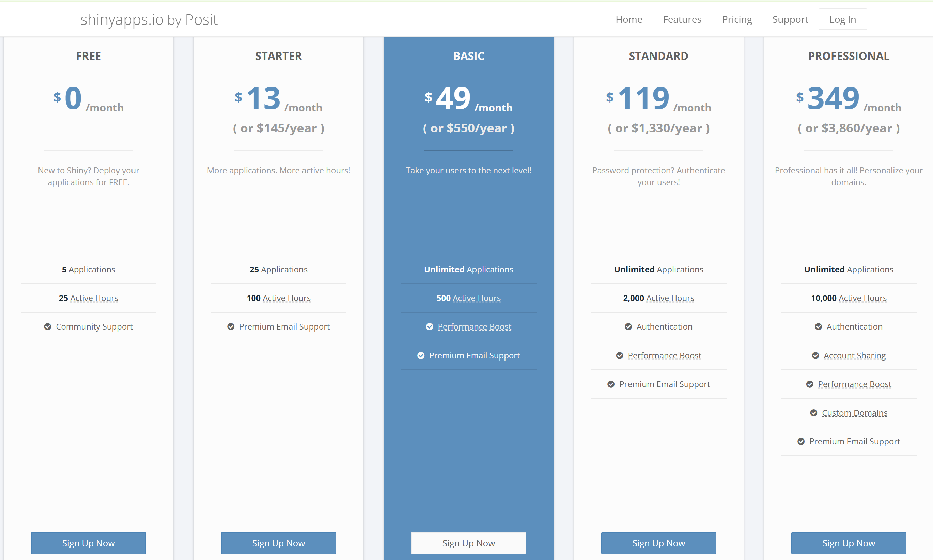
Shinyapps.io Details

Slide 41
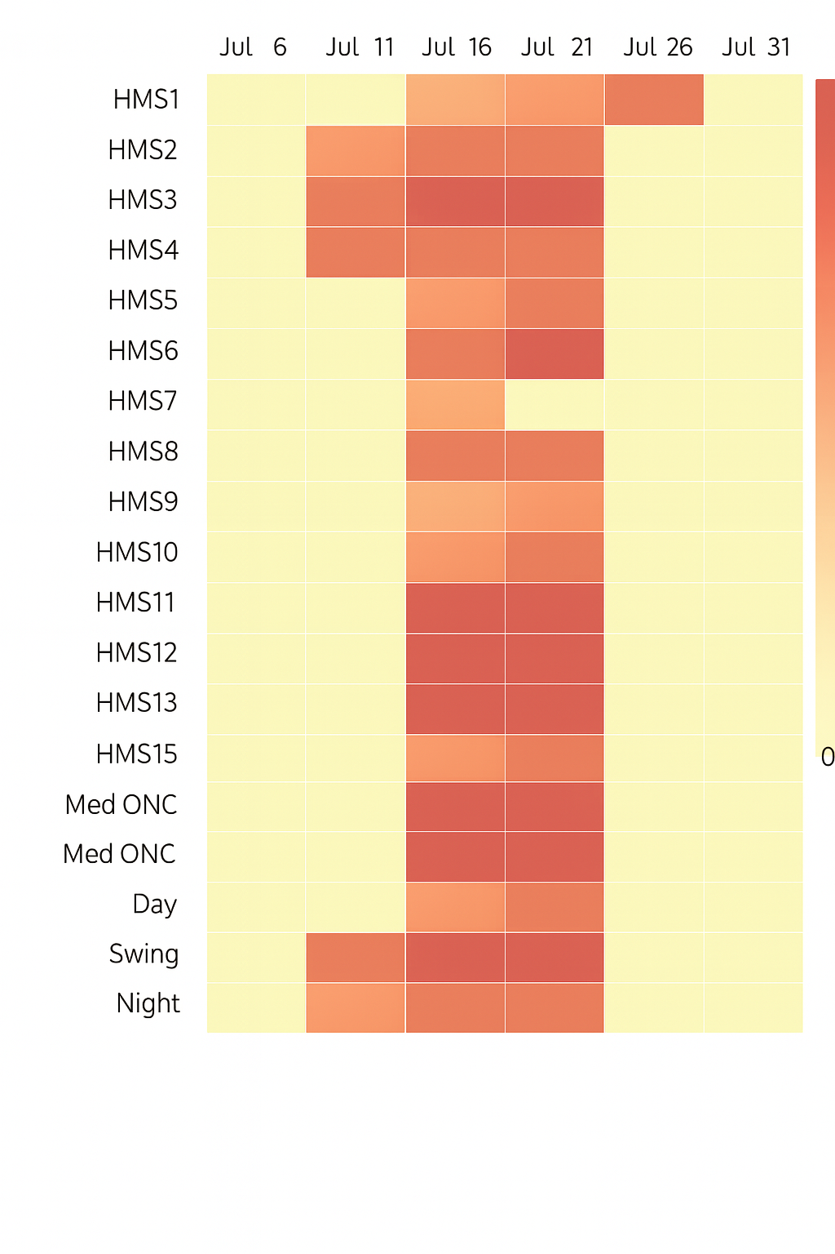
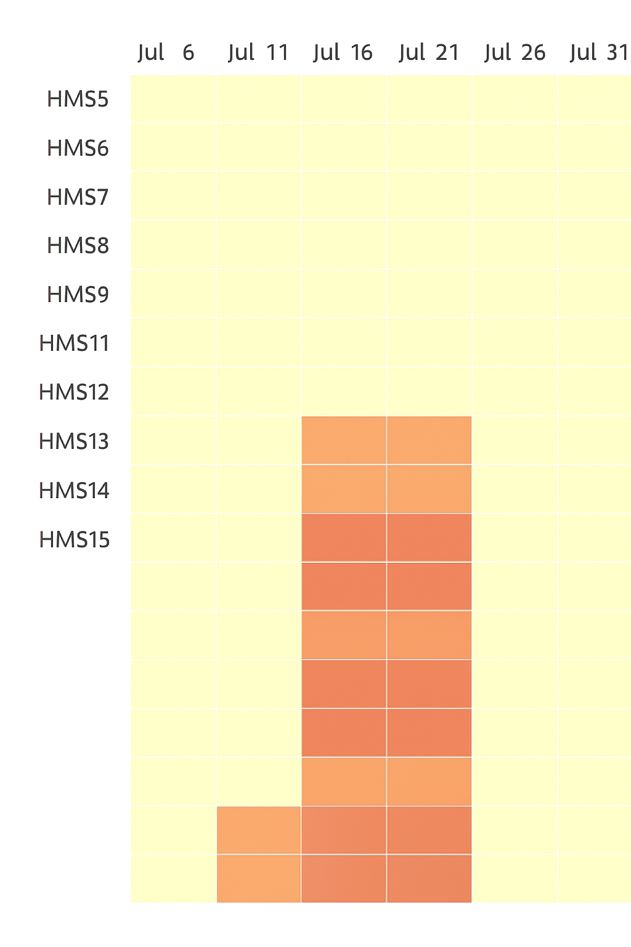
Additional Plot Ideas
Patient Volumes above 80% Capacity by Team
(Made by ChatGPT)
Heatmap
To quickly visualize Service Lines / Teams that are > 80% capacity
Could place somewhere on the dashboard for an at-a-glance pressure check
Could reveal unique trends
E.g. all teams having spikes on those days
Vs only a few teams having spikes

